Slide 1




Group 6
H-InsureLite
Project Final
Presented By:
C0898968 - Caio Vinicius Pellegrini
C0891250 - Diana Marcela Nunez Grijalba
C0901322 - Ixchel Navarrete Ruiz
C0894282 - Julio Israel Cordero Ticse
C0904148 - Juan Felipe Fuentes Mendez
Professor Parth Dave
Lambton College
3034 - Sentiment Analysis and Text Mining
August 03, 2024

Slide 2





Introduction
Main Concepts
Why ALBERT ?
Normalization
GridSearchCV
EFFICIENCY
PERFORMANCE
SCALIBILITY
TRANSFER LEARNING
ECOSYSTEM
ALBERT
DESIGN AND CAPABILITIES
Memory efficient and faster than BERT.
Sentiment Analysis, question answering, and text classification.
Beneficial while working with large datasets.

Slide 3


BUSINESS PROBLEM
Way to play I
Health Insurance: companies provide coverage that pays for medical and surgical expenses incurred by insured.
Data integration features simplicity and user friendly.
Pay-as-you go pricing.
Everything is customizable, and customers know. technology = speed. Customer expectations is growing
Way to play II
Competitive prices
Product variety
Product expertise
Digital offering
Source: PwC 2021 survey of 6,000 insurance customers.
Align all sells with our economical strategy
Be creative with our solutions
Assure compliance with regulatory organizations.

Slide 4
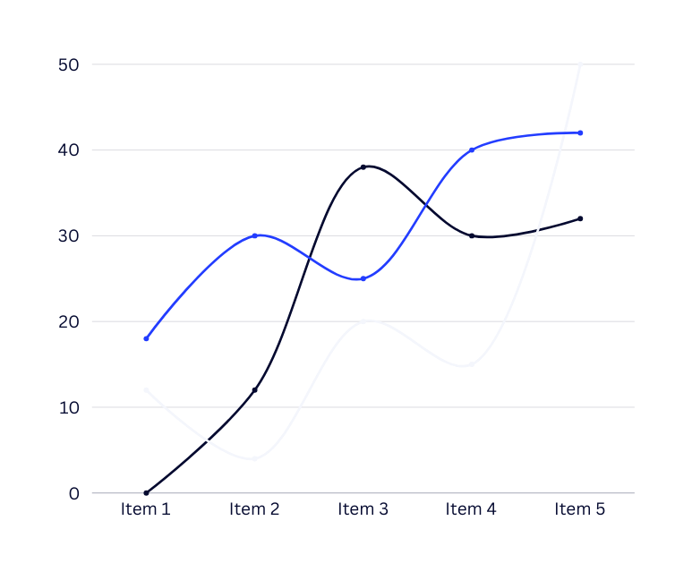

Our project's financial viability
Latest market data
Key Metrics:
Revenue & Profit Margins.
Expense Ratios.
Growth Indicators.
Solvency and Liquidity to meet obligations.

Slide 5








NLP pipeline
This dataset is obtained from Kaggle.
https://www.kaggle.com/datasets/sridharstreaks/insurance-data-for-machine-learning/data
Normalization: Using a standard scaler to reduce numerical features to a similar size.
Categorical Encoding: Encoding categorical features using label encoding or one-hot encoding.
Feature Selection: Identifying and selecting relevant features from the dataset.
Data Splitting and Scaling: Splitting the data into training and testing sets, then scaling the features to prepare them for model training.
Model Training: Training a linear regression model using the scaled training data.
Hyperparameter Tuning: Using GridSearchCV to find the best hyperparameters for a logistic regression model. This step involves discretizing the target variable and performing cross-validation to select the best model.
Data cleaning included inspecting for missing values and filling them, renaming columns for clarity, and ensuring that the data types are appropriate.
1
2
3
4
Data Acquisition and Cleaning
Preprocessing
Feature Engineering
Model Training
Evaluation Metrics: Evaluating the trained model using metrics like Mean Squared Error (MSE), Mean Absolute Error (MAE), and R2 score to understand its performance on the test set.
Streamlit Deployment:
Installing necessary packages and running the Streamlit app to serve the model are the first steps in preparing the model for deployment using Streamlit.
Albert Question Answering
The app uses the Albert model from Hugging Face to provide answers to users' insurance questions based on their context. To provide more comprehensive information, the deep learning model is combined with the natural language processing model.
5
6
7
Model Evaluation
Deployment with Streamlit
Monitoring

Slide 6




Conclusion &
Recommendations
The NLP for H-Insurelite:
Solving Business Problem:
Recommendations & Future Work
Exceed customer Expectations
Pricing Strategy
Product Expertise & Creativity
Regulatory Compliance
Model Improvement (Random Forest)
Feature Engineering (adding new features)
Data Increase
Monitoring & Maintenance
Compliance & Security
Coding:
Next Steps
Data Acquisition & Cleaning
Preprocessing
Feature Engineering
Model Training
Model Evaluation
Deployment with Streamlit
Monitoring
Evaluate advanced models
Implement monitoring tools
Gather user feedback
Ensure comprehensive documentation

Slide 7






TEAM
Ixchel
Diana
Caio
Julio
Juan
Leverage ideas to stablish objectives in the project.. Define the problem, scope and possible solutions. Create successful Python codes to see the feasible selection feature engineering . Get involve with the team needs.
In this project, I developed a model that estimates medical charges based on user inputs and provides insurance advice.
I’m the one doing Q&A for the project, also I’m studying new features that can be added to present model of h-InsureLite
My contribution for the project is managing the financial matters of the company to deliver outstanding information to relevant stakeholders. ​
My contribution to the project is to explain why we are using NLP with Albert and explain some introductory concepts to understand the code.

Slide 8


Group 6
Thank You
For your Attention

